Slide 1
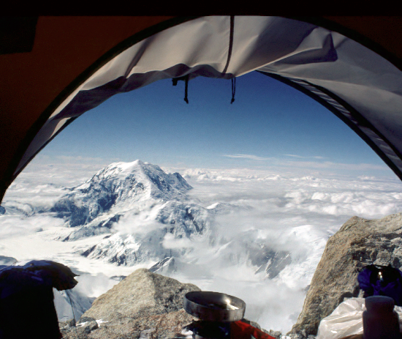
Chapter 6 System Design: Decomposing the System

Slide 2
Where are we?
We have covered Introduction (Ch 1), Chapter on Object Design (Ch 5), Requirements Eliciations (Ch 4), Analysis (Ch 5), and Chapter 2 (UML).
We are moving to Chapter 6 (System Design)
Notes:
The lectures do not follow the book verbatim
The best way to prepare for the lecture is to read the relevant material before the lecture
We are in the middle of Chapter 4
Functional modeling: Scenarios and Use casesReread Ch 2, pp. 46 - 51
Structural modeling: Class diagrams: Reread Ch 2, pp.52 - 59

Slide 3
Announcements
Mid-term exam
Projects
Homework 2

Slide 4
Overview
System Design I (This Lecture)
0. Overview of System Design
1. Design Goals
2. Subsystem Decomposition, Software Architecture
System Design II (Next Lecture)
3. Concurrency: Identification of parallelism
4. Hardware/Software Mapping:
Mapping subsystems to processors
5. Persistent Data Management: Storage for entity objects
6. Global Resource Handling & Access Control:
Who can access what?)
7. Software Control: Who is in control?
8. Boundary Conditions: Administrative use cases.

Slide 5
Introductions
System design is not algorithmic
System design is the transformation of an analysis model into a system design model.
During system design;
we define the design goals of the project
We decompose the system into smaller subsystems that can be realized by individual teams

Slide 6
Cont..
Designer select the following strategies for building the system
the hardware/software strategy
the persistent data management strategy
the global control flow
the access control policy
the handling of boundary conditions.
The result of system design is a model that includes a subsystem decomposition and a clear description of each of these strategies.

Slide 7
System design activities
Identify design goals.
Design the initial subsystem decomposition.
Refine the subsystem decomposition to address the design goals.

Slide 8
Design Engineering
What is design?
It is where you stand with a foot in two worlds – the world of technology and the world of people – and you try to bring the two together.
Design engineering is the last software engineering action within the modeling activity.
It sets the stage for construction
Design creates a representation or model of the software
Analysis Model
Focuses on describing requirements
Functional behaviors
Dynamic behaviors
Object Model
Design Model
Provides detail about data structure, architecture, interfaces, and implementation platform

Slide 9
System Concepts
During the design process the software requirements model (functional, behavior) is transformed into design models that describe the details of:
The data structures
System architecture
Interfaces
Components necessary to implement the system
Each Design Product is reviewed for:
Quality
Errors
Inconsistencies (Omissions )
Whether better alternatives exit
Whether the design model can be implemented

Slide 10
Analysis Model Contains
A set of non- functional requirements and constrains
Use cases and scenarios
Object Model
Sequence Diagrams
The analysis model describes the system completely from the actors point of view
Serves as the basis of communication between the client and the developers

Slide 11
Analysis Model does not Contains
Information about the internal structure of the system.
Implementation structure
The system hardware configuration
How the system should be realized

Slide 12
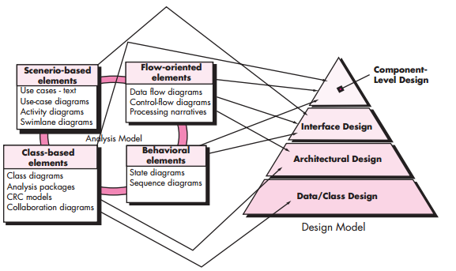
Translating the Analysis Model into the Design Model

Slide 13
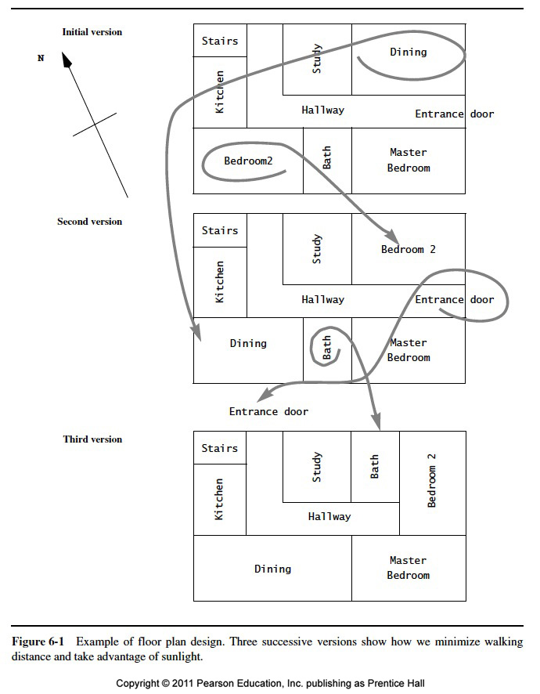

Slide 14
Why is Design so Difficult?
Analysis: Focuses on the application domain
Design: Focuses on the solution domain
The solution domain is changing very rapidly
Halftime knowledge in software engineering: About 3-5 years
Cost of hardware rapidly sinking
Design knowledge is a moving target
Design window: Time in which design decisions have to be made.

Slide 15
The Scope of System Design
Problem
Bridge the gap
between a problem and an existing system in a manageable way
System
Design
How?
Use Divide & Conquer:
1) Identify design goals
2) Model the new system design as a set of subsystems
3-8) Address the major design goals.
Existing System

Slide 16
System Design: Eight Issues
System Design
8. Boundary
Conditions
1. Identify Design Goals
Additional NFRs
Trade-offs
Initialization
Termination
Failure.
2. Subsystem Decomposition
7. Software
Control
Layers vs Partitions
Coherence & Coupling
Monolithic
Event-Driven
Conc. Processes
3. Identify Concurrency
Identification of
Parallelism
(Processes,
Threads)
4. Hardware/
Software Mapping
5. Persistent Data
Management
6. Global Resource
Handlung
Identification of Nodes
Special Purpose Systems
Buy vs Build
Network Connectivity
Storing Persistent Objects
Filesystem vs Database
Access Control
ACL vs Capabilities
Security
Notes:
1. Design goals
2. System decomposition
Breaking the system into subsystems, Layers and partitions, System information flow (topology)
3. Identification of concurrency
Threads of control
4. Hardware/software allocation
Estimate hardware requirements, Hardware/software trade-offs, Describe processor allocation, Physical connectivity (existing hardware)
5. Data management
Data structures implemented in memory or secondary storage
6. Global resource handling
Choose access control
7. Software control implementation
Procedure-based, event-based, concurrent systems
8. Boundary conditions
Describe behavior at initialization, termination and failure
9. Feasibility
Discuss design alternatives, Technological constraints that drive the design, What if the constraints change?

Slide 17
Analysis Sources: Requirements and System Model
Functional Model
8. Boundary
Conditions
1. Design Goals
Nonfunctional
Requirements
Definition
Trade-offs
Initialization
Termination
Failure
Functional Model
2. System Decomposition
Dynamic
Model
7. Software
Control
Layers vs Partitions
Coherence/Coupling
Monolithic
Event-Driven
Conc. Processes
Dynamic
Model
3. Concurrency
Object Model
Identification of
Threads
4. Hardware/
Software Mapping
5. Data
Management
6. Global Resource
Handlung
Special Purpose Systems
Buy vs Build
Allocation of Resources
Connectivity
Persistent Objects
Filesystem vs Database
Access Control List
vs Capabilities
Security

Slide 18
How the Analysis Models influence System Design
Nonfunctional Requirements
=> Definition of Design Goals
Functional model
=> Subsystem Decomposition
Object model
=> Hardware/Software Mapping, Persistent Data Management
Dynamic model
=> Identification of Concurrency, Global Resource Handling, Software Control
Finally: Hardware/Software Mapping
=> Boundary conditions
Notes:
In Requirements analysis we have beautifully built 3 descriptions of the problem, the models.
Where do the models go in system design? The above list of system design issues looks a little bit random.
But there is a reason behind it:
Nonfunctional Requirements
=> Definition of Design Goals
Functional model
=> Subsystem Decomposition (Subsystems based on functional requirements, coherence & coupling)
Object model
=> Hardware/software Mapping and Data Management (Persistent objects)
Dynamic model
=> Identification of Concurrency, Global Resource Handling, Software Control
Finally: From the Subsystem Decomposition
=> Boundary conditions

Slide 19
From Analysis to System Design
Nonfunctional
Requirements
Functional Model
8. Boundary
Conditions
1. Design Goals
Definition
Trade-offs
Initialization
Termination
Failure
Functional Model
2. System Decomposition
Dynamic
Model
Layers vs Partitions
Coherence/Coupling
7. Software
Control
Dynamic
Model
Object Model
Monolithic
Event-Driven
Conc. Processes
4. Hardware/
Software Mapping
5. Data
Management
6. Global Resource
Handlung
3. Concurrency
Identification of
Threads
Special Purpose Systems
Buy vs Build
Allocation of Resources
Connectivity
Persistent Objects
Filesystem vs Database
Access Control List
vs Capabilities
Security
Notes:
1. Design goals
2. System decomposition
Breaking the system into subsystems, Layers and partitions, System information flow (topology)
3. Identification of concurrency
Threads of control
4. Hardware/software allocation
Estimate hardware requirements, Hardware/software trade-offs, Describe processor allocation, Physical connectivity (existing hardware)
5. Data management
Data structures implemented in memory or secondary storage
6. Global resource handling
Choose access control
7. Software control implementation
Procedure-based, event-based, concurrent systems
8. Boundary conditions
Describe behavior at initialization, termination and failure
9. Feasibility
Discuss design alternatives, Technological constraints that drive the design, What if the constraints change?

Slide 20
Example of Design Goals
Reliability
Modifiability
Maintainability
Understandability
Adaptability
Reusability
Efficiency
Portability
Traceability of requirements
Fault tolerance
Backward-compatibility
Cost-effectiveness
Robustness
High-performance
Good documentation
Well-defined interfaces
User-friendliness
Reuse of components
Rapid development
Minimum number of errors
Readability
Ease of learning
Ease of remembering
Ease of use
Increased productivity
Low-cost
Flexibility

Slide 21
Stakeholders have different Design Goals
Low cost
Increased productivity
Backward compatibility
Traceability of requirements
Rapid development
Flexibility
Functionality
User-friendliness
Usability
Ease of learning
Fault tolerant
Robustness
Runtime
Efficiency
Reliability
Portability
Good documentation
Client
(Customer)
End
User
Minimum # of errors
Modifiability, Readability
Reusability, Adaptability
Well-defined interfaces
Developer/
Maintainer

Slide 22
Typical Design Trade-offs
Functionality v. Usability
Cost v. Robustness
Efficiency v. Portability
Rapid development v. Functionality
Cost v. Reusability
Backward Compatibility v. Readability
Notes:
Example: Functionality vs usability. Is a system with 100 functions usable? How about a large scale menu?
Low Cost vs Robustness: A low cost system does not check for errors when the user is entering wrong data
(ebay Entry 5.00 vs 5,00). Let‘s say you bid for 5, 00 Euro
In Germany 5,00 is 5 Euros, if the entry routine expects a „.“, then the „,“ might be overlooked,
and you have bidden. for 500 Dollars!
Efficiency vs Portability: Can you build a portable real-time game? How do you get high framerates. Special graphics routines that access the display buffer! That is usually not portable. If you write portable graphics code, say with the OpenGL, then you sometimes might not get the response times you are looking for. All special graphics code is still hand-tailored for a specific machine or graphics processor.
Rapid development vs. functionality: Let’s say your development time is 5 weeks, you have 5 programmers, your design window is 2 weeks, after design 3 programmers are leaving your company, and your delivery deadline cannot be moved. You are going to reduce the functionality. Not all the use cases in your model can be implemented nor delivered.
Cost vs. Reusability: This is an interesting trade-off, whose validity is changing right now. In the past, if you tried to make your design reusable you had to add extra effort. Recode your data structures (move from array of int to array of Generic). Moving from a 1-1 association to a many-many association involved more coding and more testing. Nowadays, with design patterns, this trade-off is changing a little bit. You can get reusability pretty cheap if you use design patterns!
Backward Compatibility vs Readability.
The same applies to this trade-off. In the past you would guarantee backward compatibility by introducing special switches.
#Ifdef OldSystem then WriteToPaperTapeWriter
#Ifdef Newsystems then WritetoCD-R
Nowadays, again with the use of design patterns, for example, the bridge pattern, you can keep a system backward compatibile and still keep it readable!

Slide 23
Subsystem Decomposition
Subsystem
It is a replacement part of the system with well-defined interfaces that encapsulates the state and behavior of its contained class
Collection of classes, associations, operations, events and constraints that are closely interrelated with each other
The objects and classes from the object model are the “seeds” for the subsystems
In UML subsystems are modeled as packages
Service
A set of named operations that share a common purpose
The origin (“seed”) for services are the use cases from the functional model
Services are defined during system design.
Notes:
Relation of subsystems to each other is similar to object model
System topology is similar functional model!
A service is a group of operations provided by the subsystem
Services are defined during system design and refined as subsystem interfaces during object design.

Slide 24
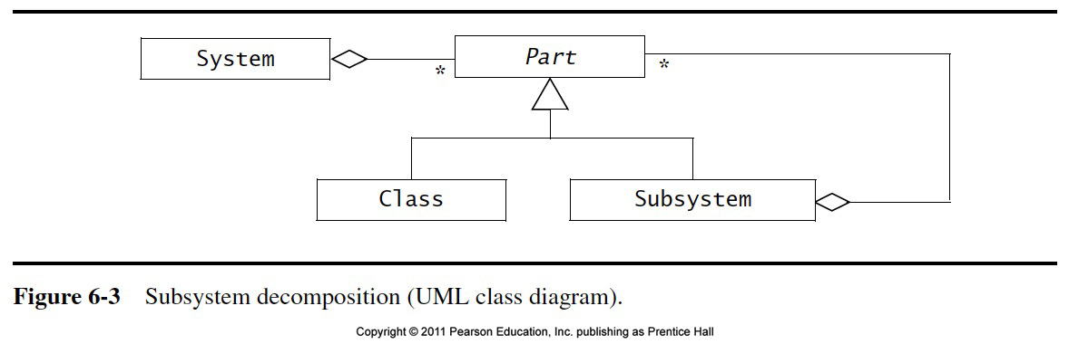

Slide 25
Cont.. (Subsystem Decomposition)
The accident management system can be decomposed into the following subsystems:
DispatcherInterface (user interface for Dispatcher)
FieldOfficerInterface (user interface for the FieldOfficer)
IncidentManagment (Responsible for creation, modification, and storage of Incidents
ResourceManagement (responsible for tracking available Resources, such as Firetruck, Ambulances)
MapManagment (depicting Maps and Locations)
Notification (implementing the communication between FieldOfficer terminal and Dispatcher stations)
The subsystem components using UML shown as rectangles with component icon in the uppor right corner
Dependencies among components can be shown with dashed arrows

Slide 26
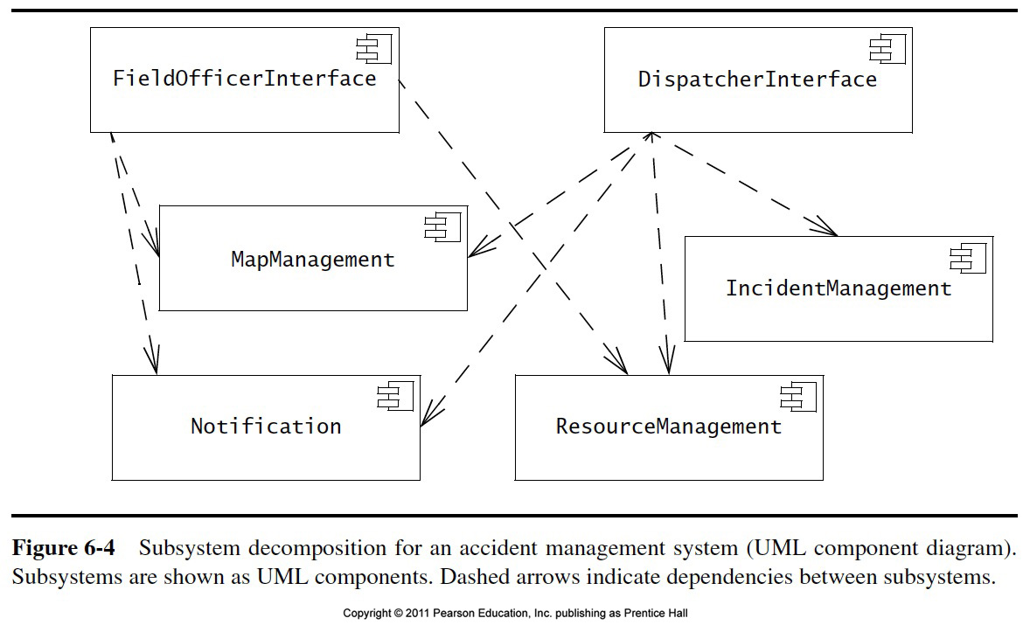

Slide 27
Cont..
A subsystem is characterized by the services it provides to other subsystems
The FieldOfficerInterface requires the ResourceUpdateService to update the status and location of the FieldOfficer
The DispatcherInterface requires the ResourceAllocation Service to identify available resource and allocate them to new Incidents
The ResourceManagment sunsystem provides both services

Slide 28
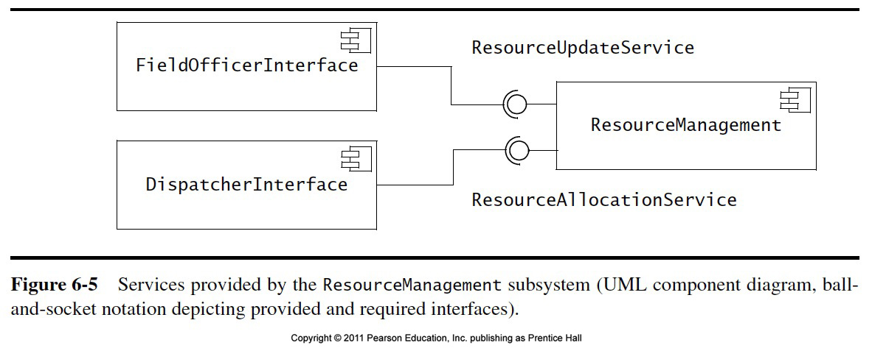
Example

Slide 29
Subsystem Interfaces vs API
Subsystem interface: Set of fully typed UML operations
The set of operations of a subsystem that are available to other subsystems
Refinement of service, should be well-defined and small
Subsystem interfaces are defined during object design
Application programmer’s interface (API)
The API is the specification of the subsystem interface in a specific programming language
APIs are defined during implementation
The terms subsystem interface and API are often confused with each other
The term API should not be used during system design and object design, but only during implementation.

Slide 30
Example: Notification subsystem
Service provided by Notification Subsystem
LookupChannel()
SubscribeToChannel()
SendNotice()
UnscubscribeFromChannel()
Subsystem Interface of Notification Subsystem
Set of fully typed UML operations
API of Notification Subsystem
Implementation in Java

Slide 31
Coupling and Coherence
Goal: Reduce system complexity while allowing change
Coherence measures dependency among classes
High coherence: The classes in the subsystem perform similar tasks and are related to each other via many associations
Low coherence: Lots of miscellaneous and auxiliary classes, almost no associations
Coupling measures dependency among subsystems
High (strongly) coupling: Changes to one subsystem will have high impact on the other subsystem
Low (loosely) coupling : A change in one subsystem does not affect any other subsystem.
Notes:
The goal is a reduction of complexity while change occurs.
A good subsystem decomposition has maximum coherence and minimum coupling:
How can we achieve high coherence?
How can we achieve low coupling?
Coherence measures dependency among classes
High coherence: The classes in the subsystem perform similar tasks and are related to each other via associations
Low coherence: Lots of miscellaneous and auxiliary classes, no associations
Coupling measures dependency among subsystems
High coupling: Changes to one subsystem will have high impact on the other subsystem (model change, massive recompilation,…)
Low coupling: A change in one subsystem does not affect any other subsystem

Slide 32
Coupling and Coherence of Subsystems
Good System Design
Goal: Reduce system complexity while allowing change
Coherence is the number of dependencies within a subsystem.
High coherence: The classes in the subsystem perform similar tasks and are related to each other via many associations
Low coherence: Lots of miscellaneous and auxiliary classes, almost no associations
Coupling measures dependency among subsystems
High coupling: Changes to one subsystem will have high impact on the other subsystem
Low coupling: A change in one subsystem does not affect any other subsystem
Notes:
The goal is a reduction of complexity while change occurs.
A good subsystem decomposition has maximum coherence and minimum coupling:
How can we achieve high coherence?
How can we achieve low coupling?
Coherence measures dependency among classes
High coherence: The classes in the subsystem perform similar tasks and are related to each other via associations
Low coherence: Lots of miscellaneous and auxiliary classes, no associations
Coupling measures dependency among subsystems
High coupling: Changes to one subsystem will have high impact on the other subsystem (model change, massive recompilation,…)
Low coupling: A change in one subsystem does not affect any other subsystem

Slide 33
Is this a Good Design?
User Interface
Component Management
Advertisement
Tournament
Tournament Statistics
No, it has too
much coupling
(“Spaghetti” Design)
Session Management
User Management
Notes:
Why is this decomposition bad? It has high coupling, almost every subsystem relies on every other subsystem.
Too much “ravioli”…..!

Slide 34
ARENA Subsystem Decomposition
User Interface
Tournament
Advertisement
User Management
Component Management
User Directory
Tournament Statistics
Session Management
Notes:
New type of association: The dashed line means “depends on at runtime”. The solid line means “depends on at compile time”.

Slide 35
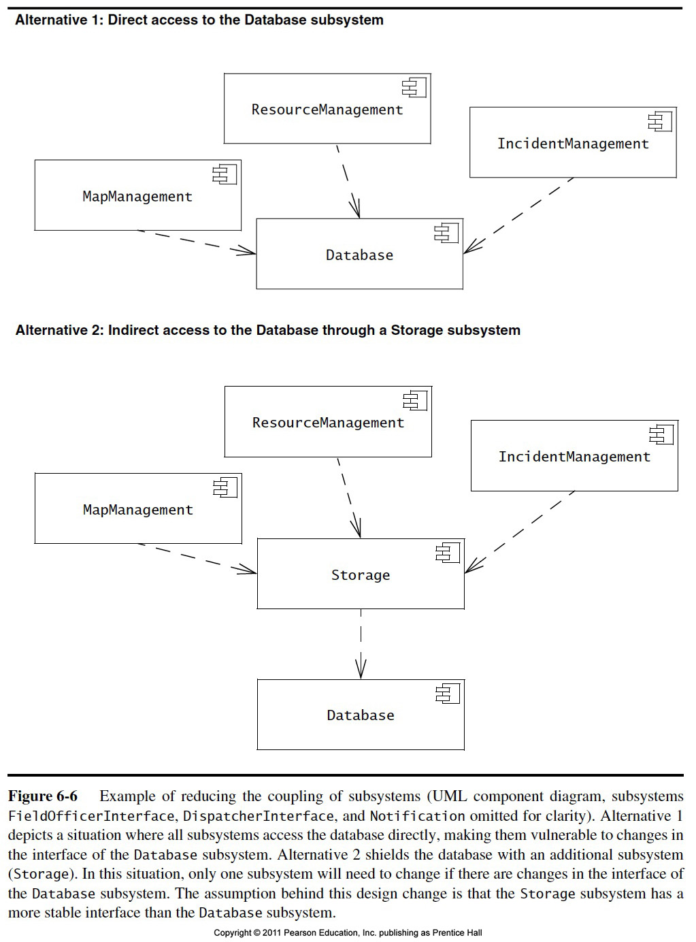

Slide 36
How to achieve high Coherence
High coherence can be achieved if most of the interaction is within subsystems, rather than across subsystem boundaries
Questions to ask:
Does one subsystem always call another one for a specific service?
Yes: Consider moving them together into the same subystem.
Which of the subsystems call each other for services?
Can this be avoided by restructuring the subsystems or changing the subsystem interface?
Can the subsystems even be hierarchically ordered (in layers)?
Notes:
What kind of model is good for describing layers and partitions? UML Class diagrams!

Slide 37

How to achieve Low Coupling
Low coupling can be achieved if a calling class does not need to know anything about the internals of the called class (Principle of information hiding, Parnas)
Questions to ask:
Does the calling class really have to know any attributes of classes in the lower layers?
Is it possible that the calling class calls only operations of the lower level classes?
David Parnas, *1941,
Developed the concept of
modularity in design.
Notes:
What kind of model is good for describing layers and partitions? UML Class diagrams!

Slide 38
The Layers of the T.H.E. System
“An operating system is a hierarchy of layers, each layers using services offered by the lower layers”
Retrospectively,
T.H.E was the first
system that used an
architectural style!
Layer 4: User Programs
Layer 3: I/O Device Manager
Layer 2: Communication with Console
Layer 1: Pager
Layer 0: Scheduler
Notes:
Appeared first in 1965, proposed by Dijkstra, 1965, in the design of the T.H.E. system.

Slide 39
Properties of Subsystems: Layers and Partitions
A hierarchical decomposition of a system yields an ordered set of layers.
A layer is a subsystem that provides a service to another subsystem with the following restrictions:
A layer only depends on services from lower layers
A layer has no knowledge of higher layers
A layer can be divided horizontally into several independent subsystems called partitions
Partitions provide services to other partitions on the same layer
Partitions are also called “weakly coupled” subsystems.
Notes:
A large system should be decomposed into subsystems using both, layers and partitions
Layering and partitioning are techniques to achieve low coupling!!!
In an object-oriented design, each subsystem makes its layer a subclass of the generic layer class provided by the UI subsystem.
In JEWEL, each individual subsystem provides its own zoom and refresh methods.
Ideally the refresh method will be called for every draw operation. The UI subsystem is responsible for knowing when to call for a refresh (but the UI group will not have to implement it itself: it is a callback method implemented by the visualization and GIS group). All the interfaces with UI (such as how UI will provide the other groups with selection information) should be well documented and agreed on by all groups.

Slide 40
Cont..(Layers and Partitions)
The layer that does not depend on any other layer is called the bottom layer.
The layer that is not used by other layer is called the top layer.
In a Closed Architecture, each layer can access only the layer immediately below it.
In an Open Architecture a layer can also access layers at deeper levels

Slide 41
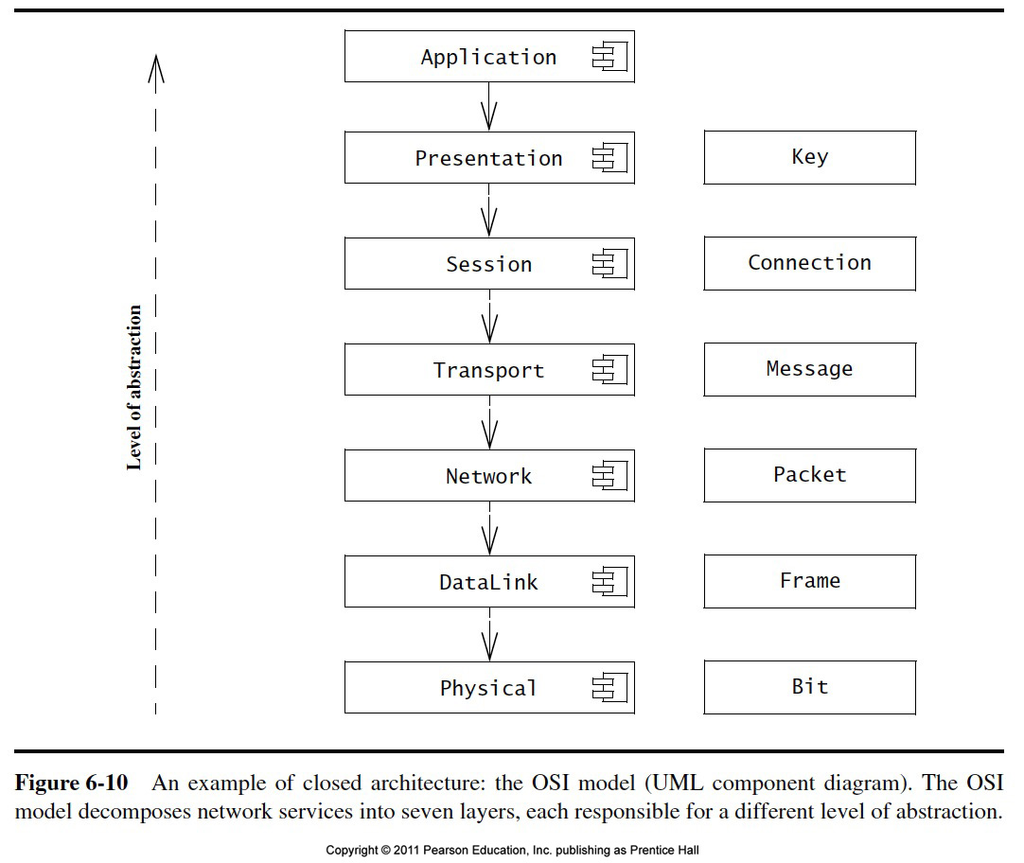
Closed architecture

Slide 42
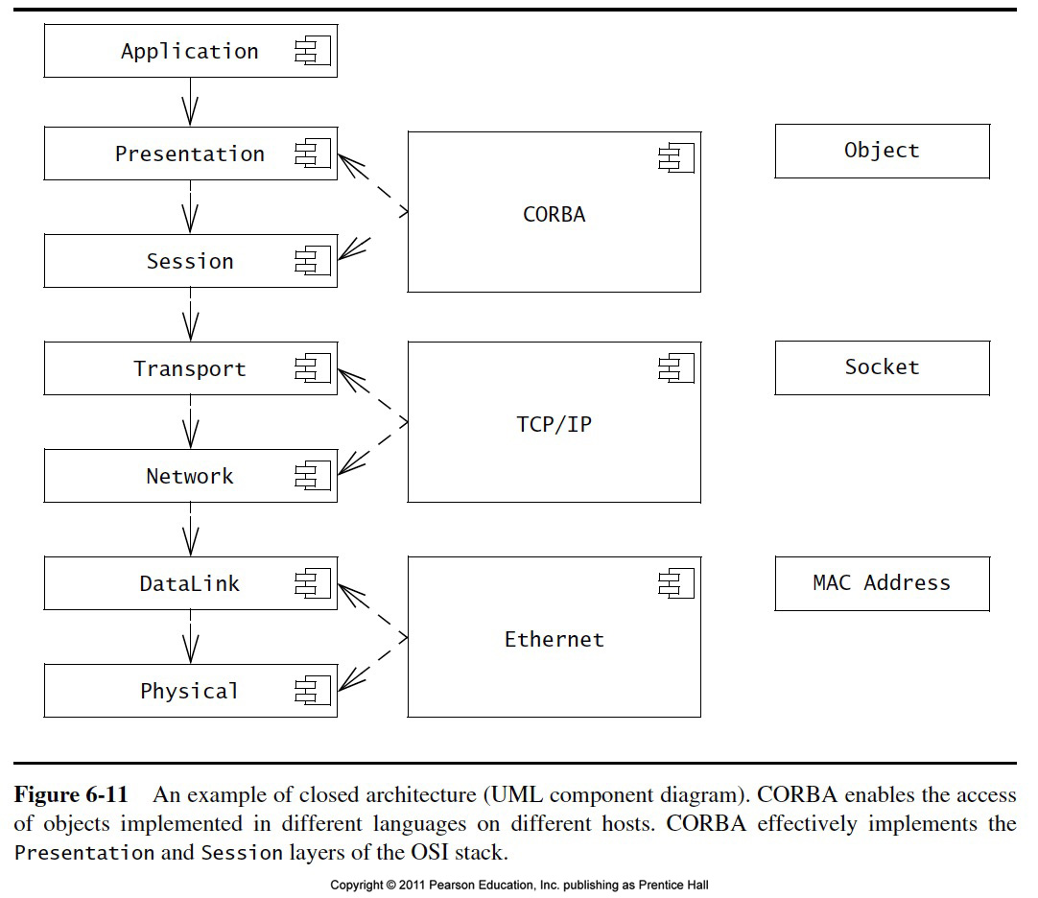

Slide 43
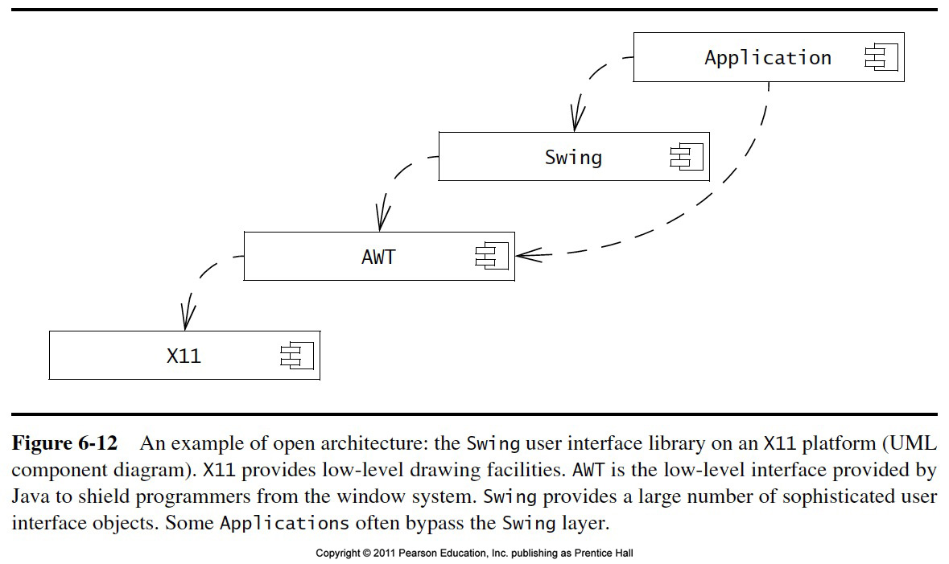
Example Open Architecture

Slide 44
Example of a Subsystem Decomposition
Partition
relationship
Layer
Relationship
„depends on“
Layer 1
A:Subsystem
Layer 2
B:Subsystem
C:Subsystem
D:Subsystem
Layer 3
E:Subsystem
F:Subsystem
G:Subsystem
Layer
Relationship
„calls“
Notes:
Subsystem Decomposition Heuristics
- No more than 7+/-2 subsystems
More subsystems increase coherence but also complexity (more services)
- No more than 4+/-2 layers
Good design: Try to find 3 layers!!!! In many cases this is possible. 3-tier-architectures are an example

Slide 45
The Layered Architectural Style
uses
Hierarchical
Relationship
Client
Layer N
calls
Layer N-1
calls
Layer N-2
...
calls
Layer 1
calls
Layer 0

Slide 46
Examples of Architectural Styles
A software architecture includes:
System decomposition, global control flow, handing of boundary conditions, and inter subsystem communication protocols.
Architectural Styles:
Client/Server
Peer-To-Peer
Three-tier, Four-tier Architecture
Repository
Model-View-Controller
Pipes and Filters
Notes:
Styles are listed in Chapter 6, p. 237
We will talk about Client-Server, Peer-To-Peer, Repository and MVC,
Only in the book: Three-tier, Four-tier , Pipes and Filters

Slide 47
Repository Architectural Style
Subsystems access and modify data from a single data structure called the repository
Historically called blackboard architecture (Erman, Hayes-Roth and Reddy 1980)
Subsystems are loosely coupled (interact only through the repository)
Control flow is dictated by the repository through triggers or by the subsystems through locks and synchronization primitives
Repositories used by:
Database systems, compilers, software development environments.
Repository
*
Subsystem
createData()
setData()
getData()
searchData()
Notes:
The first blackboard architecture was realized
in the Hearsay II Speech Recognition System at Carnegie Mellon

Slide 48
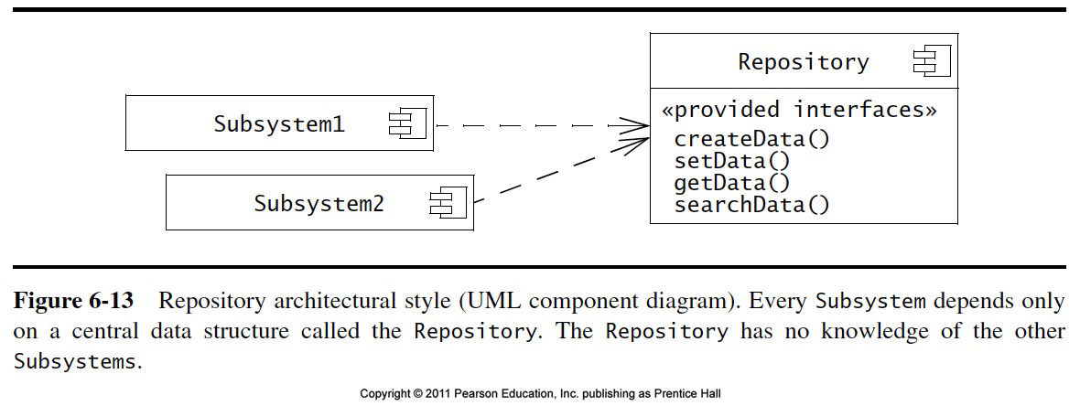
Database system Example

Slide 49
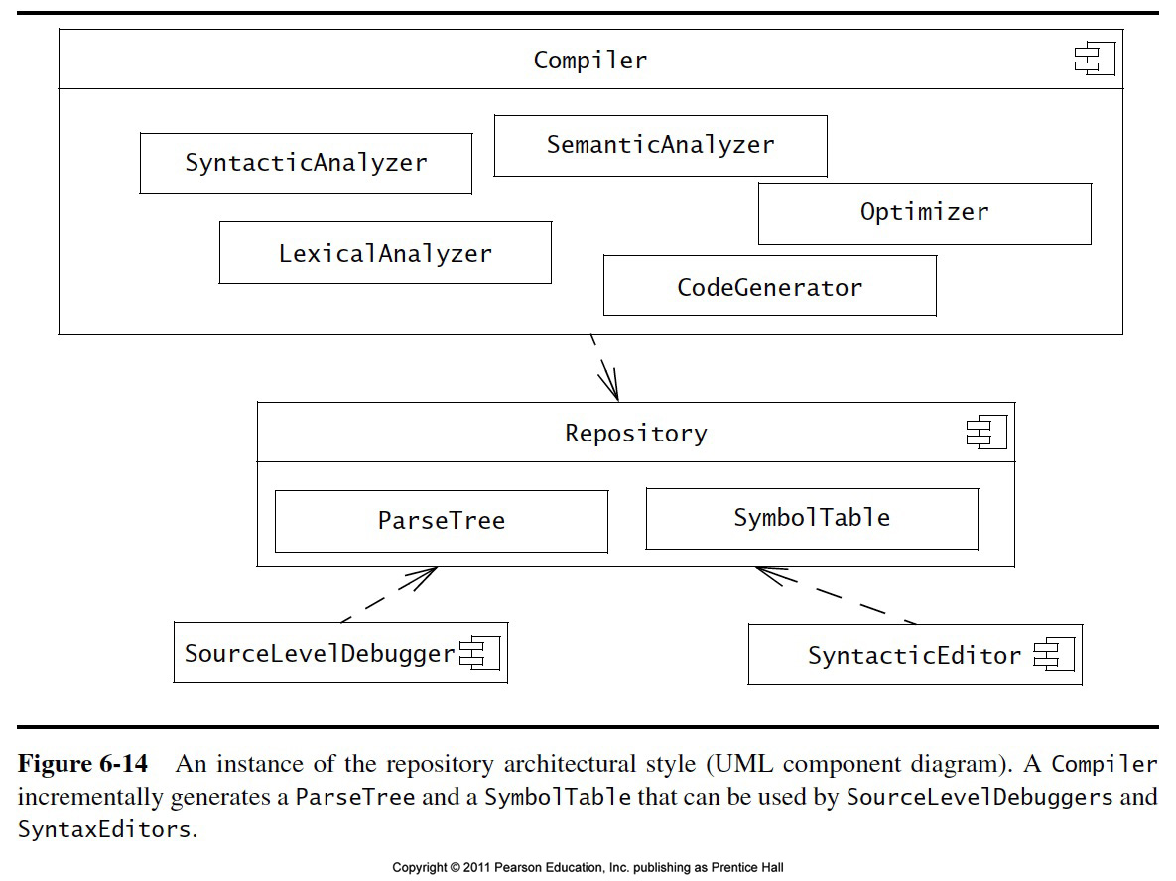
Compiler Example

Slide 50
Model-View-Controller Architectural Style
Subsystems are classified into 3 different types
Model subsystem: Responsible for application domain knowledge (Entity Object)
View subsystem: Responsible for displaying application domain objects to the user
Controller subsystem: Responsible for sequence of interactions with the user and notifying views of changes in the model
Class Diagram
initiator
Controller
1
repository
*
Model
1
notifier
subscriber
View
*
Better understanding with a Collaboration Diagram
Notes:
The MVC style is a special case of the repository architectural style:
Model subsystem implements the Repository, the Controller subsystem explicitly dictates the control flow
Example: Filesystem based on MVC

Slide 51
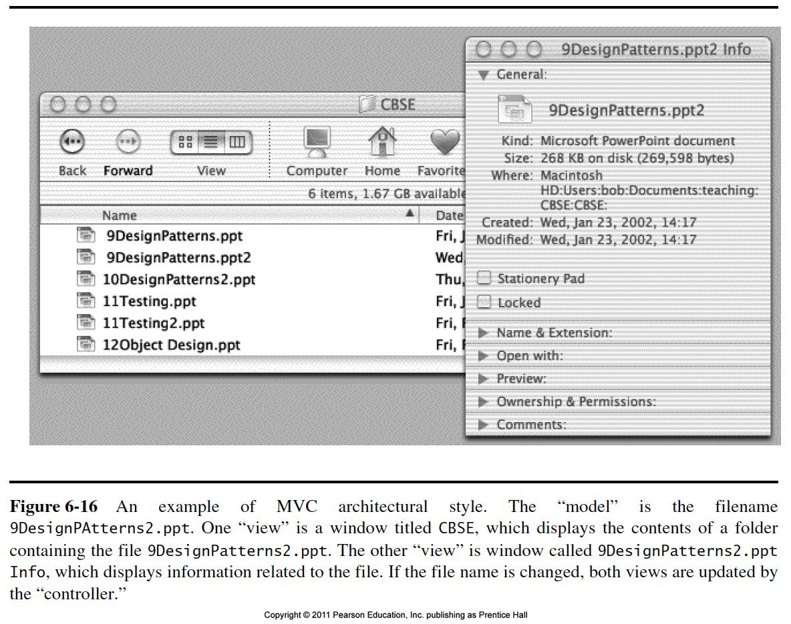
Example

Slide 52
Change the name of file
The InfoView and the FolderView both subscribe for changes to the File models they display
The user types the new name for the file
The Controller, the object responsible for interacting with the user during file name changes, sends a request to the Model
The Model changes the file name and notifies all of the subscribers of the changes
Both InfoView and FolderView are updated, so the user sees a consistent change

Slide 53
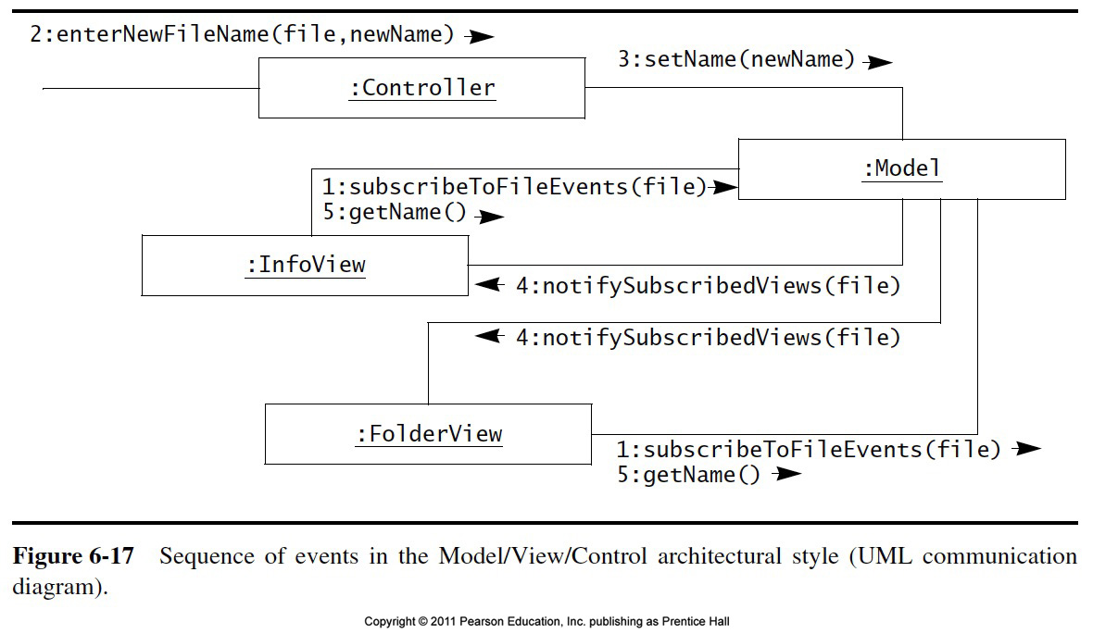
Cont..

Slide 54
Client/Server Architectures
Often used in the design of database systems
Front-end: User application (client)
Back end: Database access and manipulation (server)
Functions performed by client:
Input from the user (Customized user interface)
Front-end processing of input data
Functions performed by the database server:
Centralized data management
Data integrity and database consistency
Database security
Notes:
Often used in the design of database systems
Front-end: User application (client)
Back end: Database access and manipulation (server)
Functions performed by client:
Customized user interface, Front-end processing of data
Initiation of server remote procedure calls, Access to database server across the network
Functions performed by the database server:
Centralized data management, Data integrity and database consistency
Database security, Concurrent operations (multiple user access)
Centralized processing (for example archiving)

Slide 55
Client/Server Architectural Style
One or many servers provide services to instances of subsystems, called clients
Each client calls on the server, which performs some service and returns the result
The clients know the interface of the server
The server does not need to know the interface of the client
The response in general is immediate
End users interact only with the client.
Server
Client
*
*
requester
provider
+service1()
+service2()
+serviceN()

Slide 56
Problems with Client/Server Architectures
Client/Server systems do not provide peer-to-peer communication
Peer-to-peer communication is often needed
Example:
Database must process queries from application and should be able to send notifications to the application when data have changed
application1:DBUser
1. updateData
database:DBMS
application2:DBUser
2. changeNotification

Slide 57
Peer-to-Peer Architectural Style
Generalization of Client/Server Architectural Style
“Clients can be servers and servers can be clients”
Introduction a new abstraction: Peer
“Clients and servers can be both peers”
How do we model this statement? With Inheritance?
Proposal 1: “A peer can be either a client or a server”
Proposal 2: “A peer can be a client as well as a server”.
Notes:
More difficult because of possibility of deadlocks
“A Peer is either a Client or a Server”What is the corresponding UML model?
Make a hint that leads to the answer, that Peer is a superclass for client and server! Use the phrase “either or” and refer to Abbott’s technique!

Slide 58
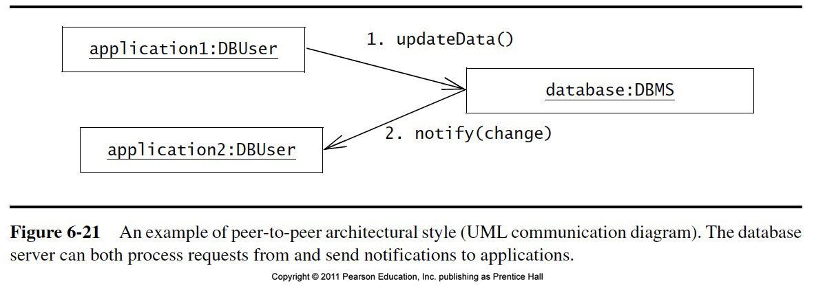
Example

Slide 59
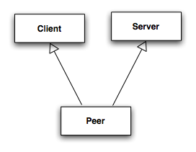
Relationship Client/Server & Peer-to-Peer
Problem statement “Clients can be servers and servers can be clients”
Which model is correct?
Model 1: “A peer can be either a client or a server”
Model 2: “A peer can be a client as well as a server”
?
Model 1
✔
Model 2
Client
Server
Notes:
More difficult because of possibility of deadlocks
“A Peer is either a Client or a Server”What is the corresponding UML model?
Make a hint that leads to the answer, that Peer is a superclass for client and server! Use the phrase “either or” and refer to Abbott’s technique!

Slide 60
3-Layer-Architectural Style 3-Tier Architecture
Definition: 3-Layer Architectural Style
An architectural style, where an application consists of 3 hierarchically ordered subsystems
A user interface, middleware and a database system
The middleware subsystem services data requests between the user interface and the database subsystem
Definition: 3-Tier Architecture
A software architecture where the 3 layers are allocated on 3 separate hardware nodes
Note: Layer is a type (e.g. class, subsystem) and Tier is an instance (e.g. object, hardware node)
Layer and Tier are often used interchangeably.

Slide 61
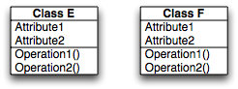
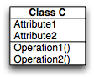
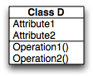
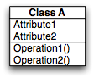
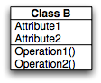
Virtual Machines in 3-Layer Architectural Style
A 3-Layer Architectural Style is a hierarchy of 3 virtual machines usually called presentation, application and data layer
Presentation Layer
(Client Layer)
Application Layer
(Middleware,
Business Logic)
Data Layer
Operating System, Libraries
Existing System
Notes:
Appeared first in 1965, proposed by Dijkstra, 1965, in the design of the T.H.E. system.

Slide 62
Example of a 3-Layer Architectural Style
Three-Layer architectural style are often used for the development of Websites:
1. The Web Browser implements the user interface
2. The Web Server serves requests from the web browser
3. The Database manages and provides access to the persistent data.

Slide 63
Example of a 4-Layer Architectural Style
4-Layer-architectural styles (4-Tier Architectures) are usually used for the development of electronic commerce sites. The layers are
The Web Browser, providing the user interface
A Web Server, serving static HTML requests
An Application Server, providing session management (for example the contents of an electronic shopping cart) and processing of dynamic HTML requests
A back end Database, that manages and provides access to the persistent data
In current 4-tier architectures, this is usually a relational Database management system (RDBMS).

Slide 64
MVC vs. 3-Tier Architectural Style
The MVC architectural style is nonhierarchical (triangular):
View subsystem sends updates to the Controller subsystem
Controller subsystem updates the Model subsystem
View subsystem is updated directly from the Model subsystem
The 3-tier architectural style is hierarchical (linear):
The presentation layer never communicates directly with the data layer (opaque architecture)
All communication must pass through the middleware layer
History:
MVC (1970-1980): Originated during the development of modular graphical applications for a single graphical workstation at Xerox Parc
3-Tier (1990s): Originated with the appearance of Web applications, where the client, middleware and data layers ran on physically separate platforms.

Slide 65
Pipes and Filters
A pipeline consists of a chain of processing elements (processes, threads, etc.), arranged so that the output of one element is the input to the next element
Usually some amount of buffering is provided between consecutive elements
The information that flows in these pipelines is often a stream of records, bytes or bits.

Slide 66
Pipes and Filters Architectural Style
An architectural style that consists of two subsystems called pipes and filters
Filter: A subsystem that does a processing step
Pipe: A Pipe is a connection between two processing steps
Each filter has an input pipe and an output pipe.
The data from the input pipe are processed by the filter and then moved to the output pipe
Example of a Pipes-and-Filters architecture: Unix
Unix shell command: ls -a l cat
A pipe
The Unix shell commands ls
and cat are Filter

Slide 67
Architectural Style vs Architecture
Subsystem decomposition: Identification of subsystems, services, and their association to each other (hierarchical, peer-to-peer, etc)
Architectural Style: A pattern for a subsystem decomposition
Software Architecture: Instance of an architectural style.
Notes:
Specification of the system decomposition is critical
An architectural style is a pattern or template for subsystem decomposition

Slide 68
An Example, MyTrip
The system design consists of transforming the analysis model into the design model that takes into account:
Nonfunctional requirements
Functional requirements
Analysis model
Mytrip is a route planning system for car drivers
All the trips must be saved for later retrieval on the server

Slide 69
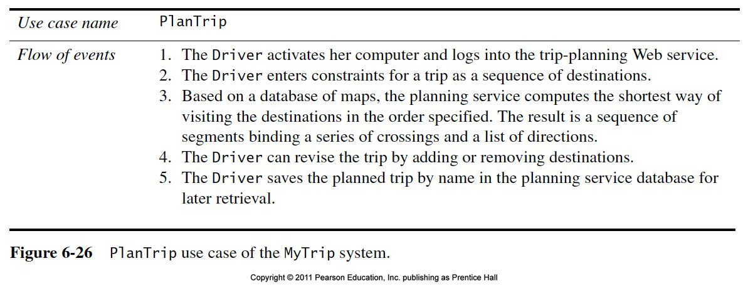
Analysis Model for a Route Planning System

Slide 70
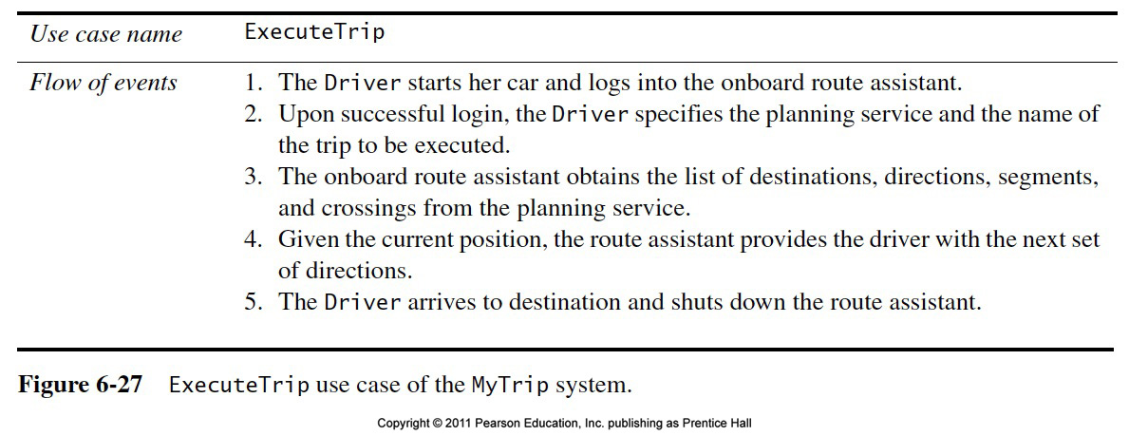
Cont.

Slide 71
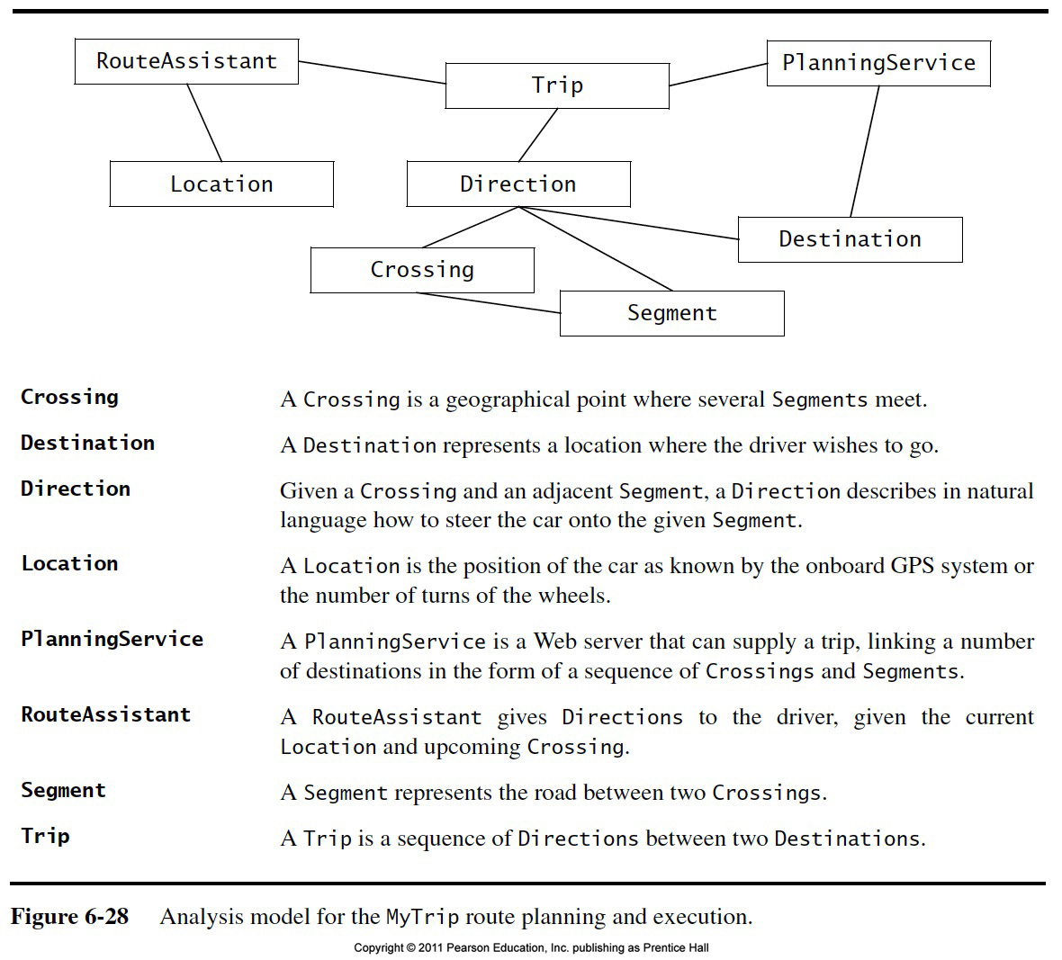
Analysis Model for MyTrip

Slide 72
Identifying Design Goal
Reliability
Fault Tolerance
Security
Modifiability

Slide 73
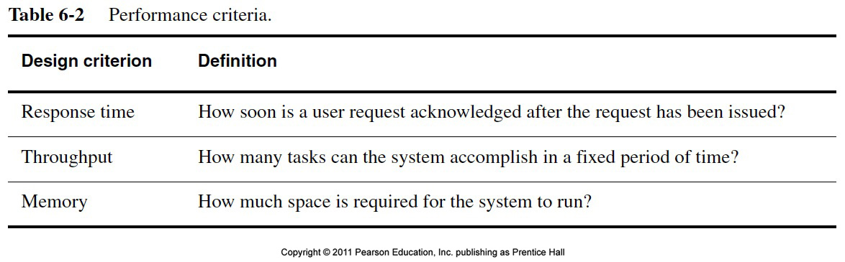
Performance Criteria

Slide 74
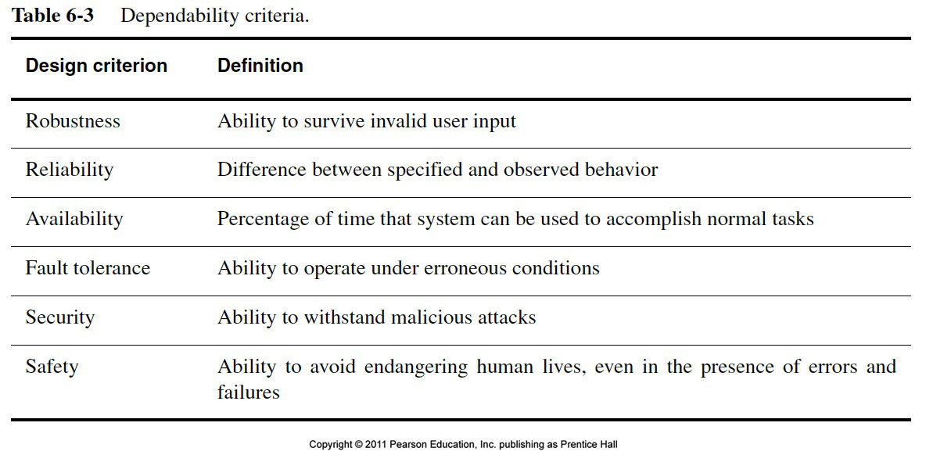
Dependability Criteria

Slide 75
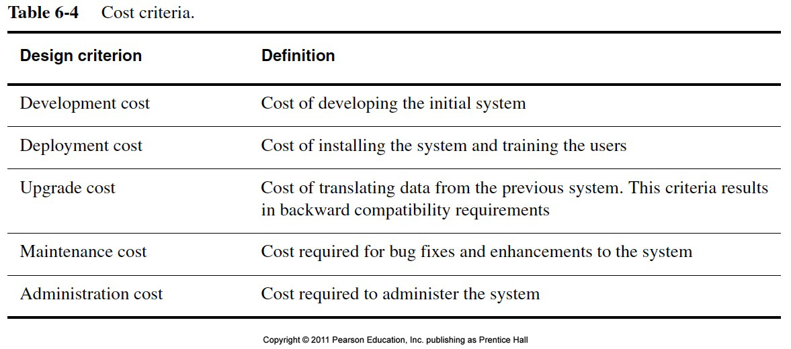
Cost Criteria

Slide 76
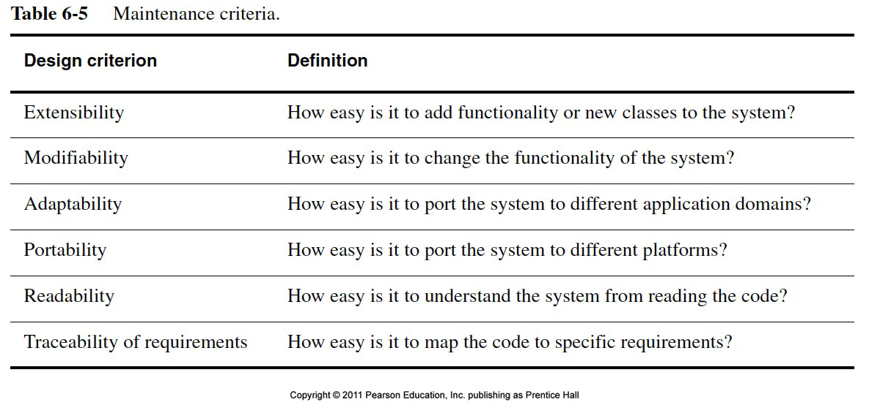
Maintenance Criteria

Slide 77
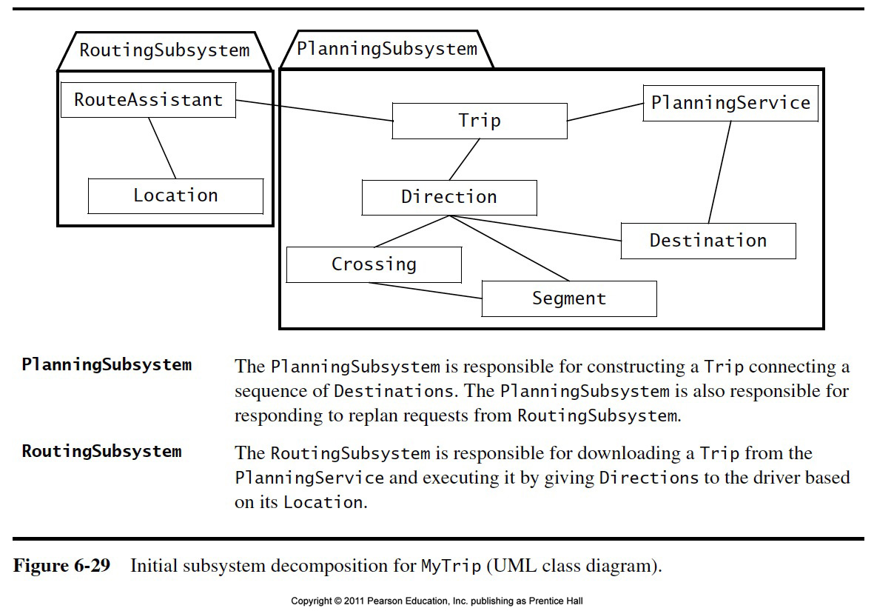

Slide 78
Summary
System Design
An activity that reduces the gap between the problem and an existing (virtual) machine
Design Goals Definition
Describes the important system qualities
Defines the values against which options are evaluated
Subsystem Decomposition
Decomposes the overall system into manageable parts by using the principles of cohesion and coherence
Architectural Style
A pattern of a typical subsystem decomposition
Software architecture
An instance of an architectural style
Client Server, Peer-to-Peer, Model-View-Controller.

